Slide 1
Data Engineering Course
Creating Data Pipe line to export file form postgresql and convert it to Json and load it to MongoDB

Slide 2
Contents
Setup the docker-compose file.
Configurations.
Open airflow, psotgresql, MongoDB.
Setup the postgresql database connection.
Run the DAG and check the pipeline

Slide 3
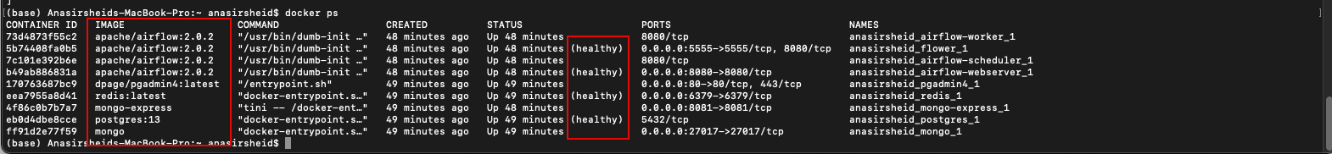
Setup the docker-compose file
The provided docker-compose file contains the configurations of all needed containers needed to create this assignment data pipeline:
Airflow containers (7 containers)- original compose file
Postgres PG admin visualization tool - added to the compose file
MongoDB and its visualization tool - added to the compose file.
Before starting Airflow for the first time, You need to prepare your environment, i.e. create the necessary files, directories and initialize the database:
1. On your command shell type: docker-compose up airflow-init , The output should be: start_airflow-init_1 exited with code 0.
2. After the above step is done type: docker-compose up
3. On new terminal tyep: docker ps ,Here you must have all services healthey and you can see the different containers under this yaml file.
4. Remember that by this setup the airflow will create three directores on your pc ./logs, ./dags ,./ plugins
We wil use the ./logs as a mapped directory to import and export the CSV file that will be used during this pipeline

Slide 4
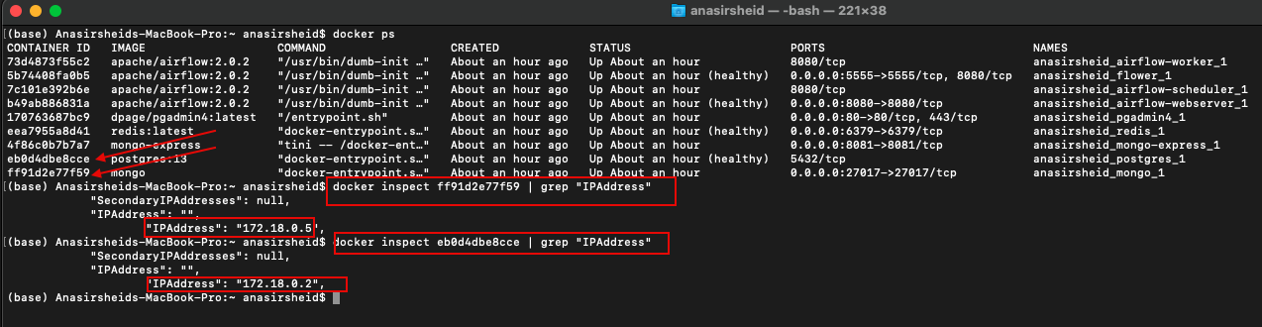
Configurations
After ensuring that all services are up and healthy we need to install the all necessary python package on the below containers:
On docker gui open cli terminals for all the three services Airflow Worker ,Airflow scheduler,Airflow flower.
On the terminals type: pip install faker, pip install config, pip install pymongo, pip install pysycopg2.
Now all services are up and healthy:
Put the assignment1.py file in the ./dag folder created by airflow.
On this .py you need to put the correct IP for MongoDB and postgresql
Open a terminal type : docker ps ,here you will have all running containers.
On the same terminal locate postgres and mongo containers and type for both : docker inspect #container ID# | grep “IPAddress”
You will have the ip address for both mongo and postgresql:
On the assignemnt1.py you need to change the ip for postgres and mongo accordinng to this output and save the file:
On lines 30 and 64 for postgresql. (write to and read from postgresql processes: postgres_dataload and export_csv_frompostgresql functions)
On line 91 for mongo DB (write to MongoDB process : JSONtoMONGODB function

Slide 5
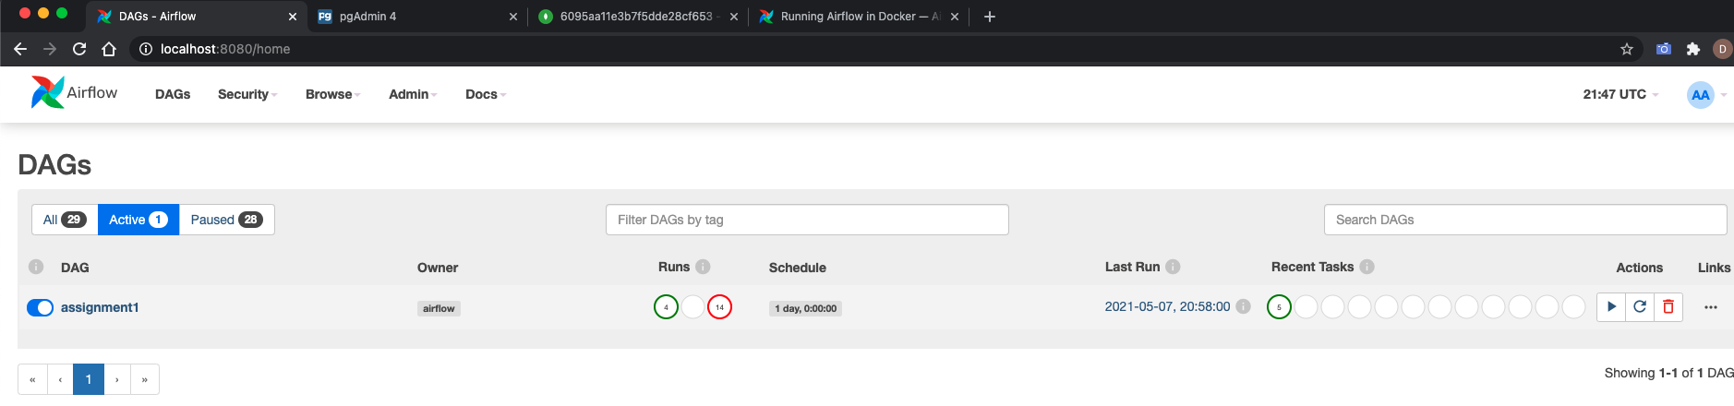
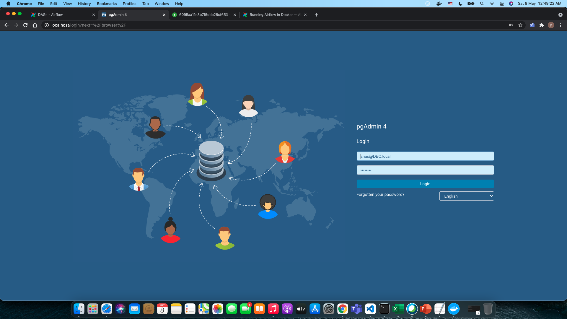
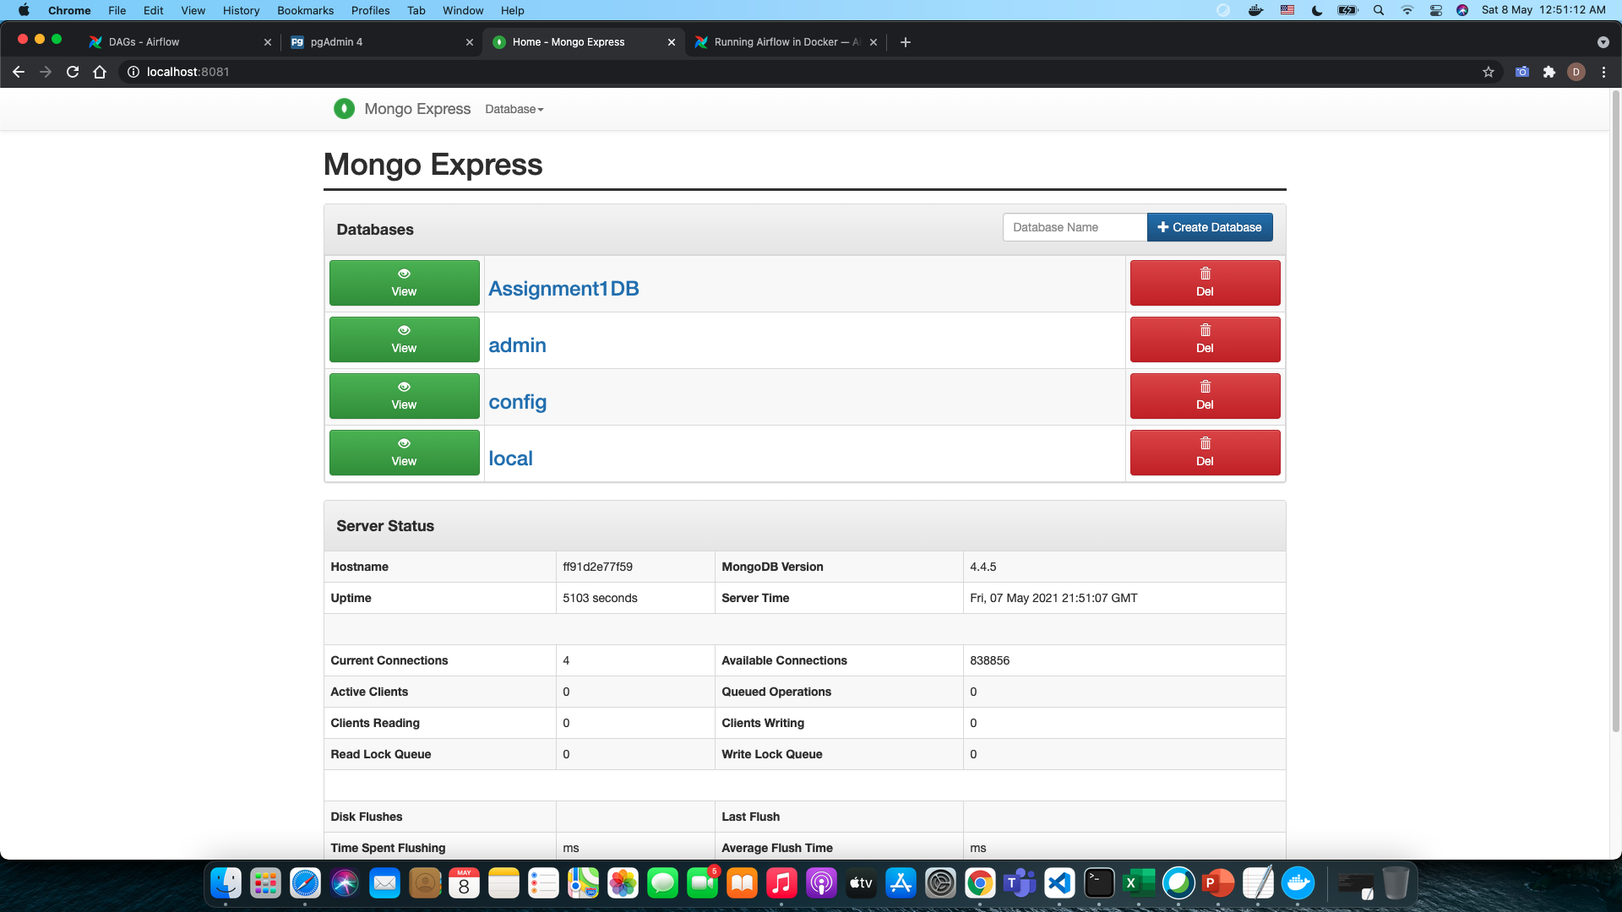
Open airflow, psotgresql, MongoDB.
To open the air flow type on your browser : localhost:8080
To open postgressql type on our browser : localhost:80 , the username = anas@DEC.local, password = DECourse.
To open MongoDB type on your browser : localhost:8081

Slide 6
Setup the postgresql database connection.
According to the ip output of the configurations step you need to configure the connection to server of postgresql database to be able to access it:
Username and password are set to airflow in docker file
After that you will be able to access the postgres data base and see the schemas and tables

Slide 7
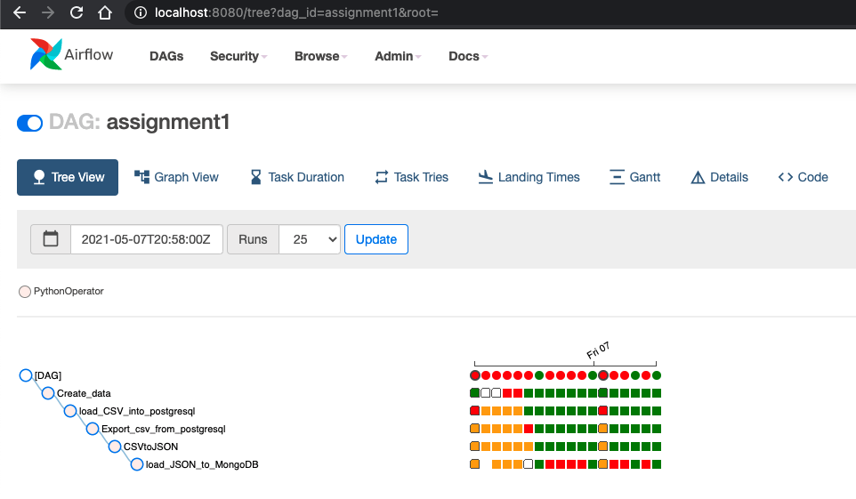
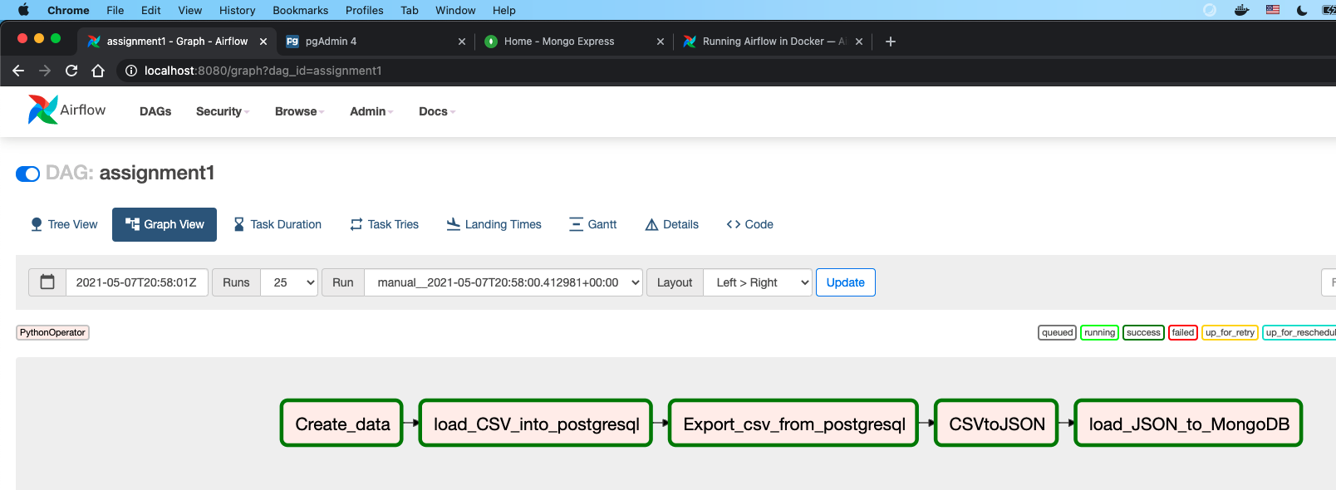
Run the DAG and check the pipeline-1
After completing the configurations step once you access the air flow you need to locate your DAG and ensure it is not broken: all steps in the MOP included to ensure the DAG assignment1 will not be broken unless you have a python package installation needed as illustrated before.
On your browser type : localhost:8080 the airflow window will open and you will be able to locate your DAG :
You can see the graph view or tree view

Slide 8
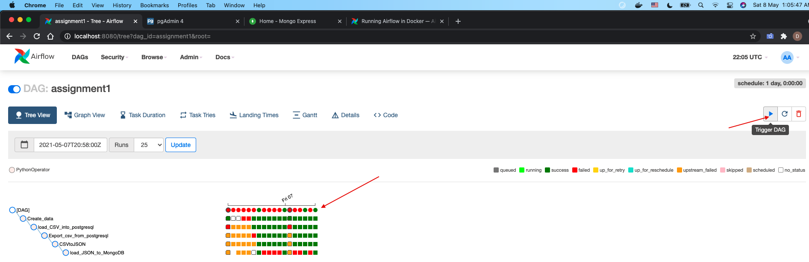
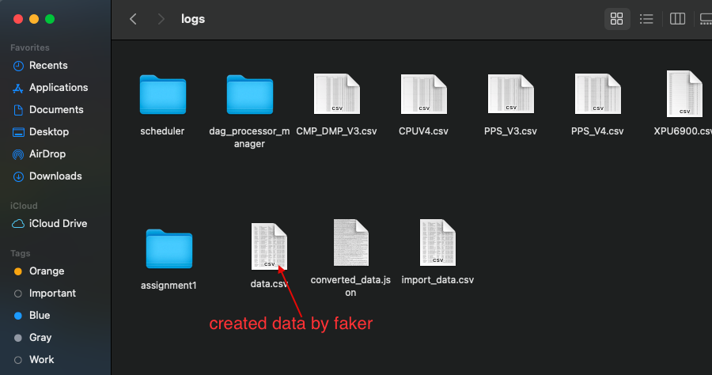
Run the DAG and check the pipeline-2- Create Data
After completing the configurations step and once you locate the assingment1 DAG you can run it and ensure it is set to green all the ways
According to the first DAG the faker will create a dummy data and store in ./logs

Slide 9
Run the DAG and check the pipeline-3- Load_csv_intopsotgresql
In PostgreSQL window refresh it and here you go the table is created according to the second step of this pipeline.

Slide 10
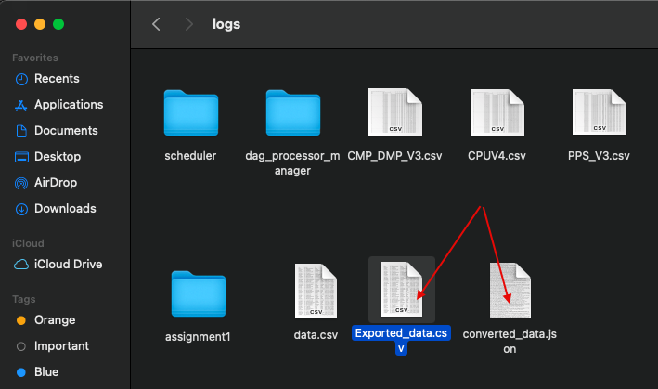
Run the DAG and check the pipeline-4- Export_csv_from_postgresql / CSVtoJSON
In the third step the process will extract a table .csv from the PostgreSQL and convert it to json file

Slide 11
Run the DAG and check the pipeline-5- load_JSON_to_MongoDB
In the last step the pipeline process will import the json file and load it into a MongoDB database:
In your browser type: localhost:8081 , here you go assignemtn1DB data base created and you can browse
The date base freely to see the collections and documents for each record

Slide 12
Thank you

